Slide 1
AVERAGE EFFECT
Mean centred melody memory covariate
17 subjects

Slide 2
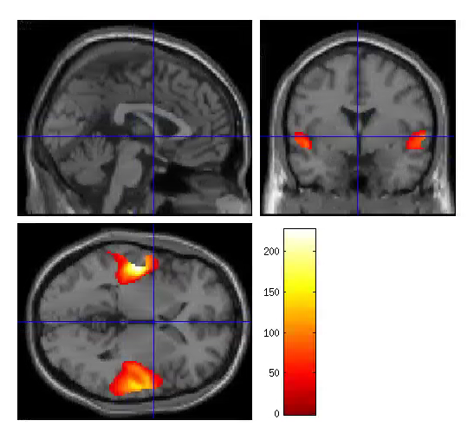
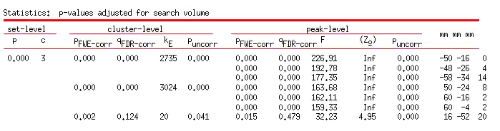
S1TBL_melmem_mean_27subj
Extent threshold = 17
P<0.05 FWE cor
Sig main effect of mel mem in both ROIs
ROI1
ROI2

Slide 3
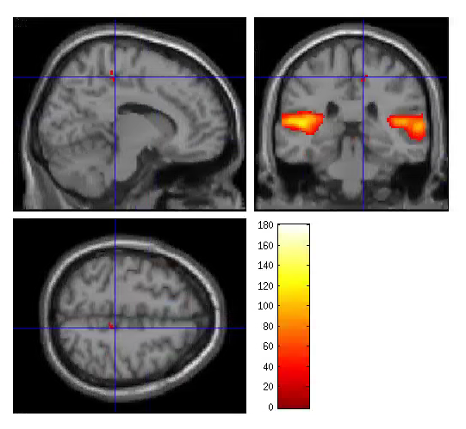
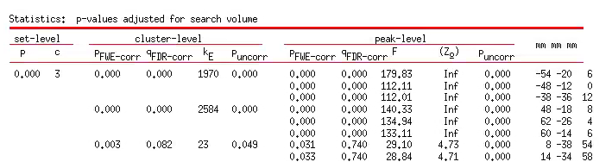
S2TBL_melmem_mean_17subj
Extent threshold = 21
P<0.05 FWE cor
ROI1
ROI2

